Slide 1

Bypassing macOS Detections with Swift
Cedric Owens
Defcon Red Team Village
August 2019

Slide 2




func aboutMe(){}
Red Team At
Austin, Texas
Blue Team Experience
MacOS Post-Ex
Enjoy 80s Nastalgia
@cedowens

Slide 3

import Agenda
MacOS ”State of the Union”
Common Post Exploitation Methods
Detection Artifacts
Migrating To MacOS Internals
Post Exploitation Examples in Swift

Slide 4

var stateOfTheUnion
Common in Bay Area
Growing in Fortune 500
EDR products improving on macOS
Lots of opportunity to advance tradecrafts

Slide 5

var stateOfTheUnion
Process and command line argument detections
Parent-child relationship detections
Scrutinizing processes with network connections
All EDR products “out the box” may not have solid detections on items above

Slide 6
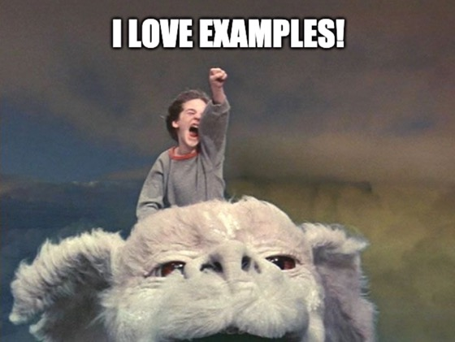
try common.PostEx(examples)
Post-Ex Goals
Gained traction ~ 3 years ago
Effective but easily detectable
Leveraged scripting frameworks
Wrapper for command-line executions

Slide 7

try common.PostEx(examples)
Wrote a lightweight Post-Ex in python
To better understand macOS Post-Ex
For easy customization
To help with detections
https://github.com/cedowens/MacShell
Easy way to find detection gaps for most python-based Post-Ex
Observed some easily detectable and common patterns

Slide 8

var commonPatterns
Parent-child relationships
os.system, os.popen commands/subprocess
Python -> /bin/sh -> command
Count of network connections from python
Command line strings
“screencapture –x”
“osascript –e” + “popup”
“osascript –e” + “clipboard”
Leave traces that can be searched

Slide 9
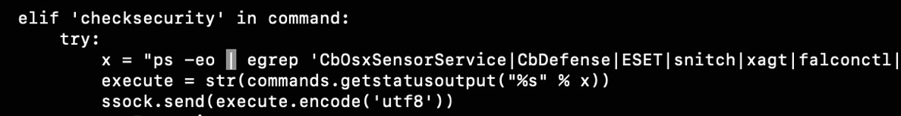
var commonPatterns
Post Exploitation Tool:
EDR Perspective:
Python
/bin/sh
/bin/ps

Slide 10
let commonPatterns
Stacked View (EDR Perspective):
/bin/sh
[command]
/bin/sh
[command]
Python
/bin/sh
[command]
/bin/sh
[command]

Slide 11

func pythonPostExSummary()
Pros:
Convenience
Allows for “living off the land”
May still go undetected in some environments today
Cons:
Easily detectable by mature teams
Reliance on command line utilities
Limited with MacOS options

Slide 12
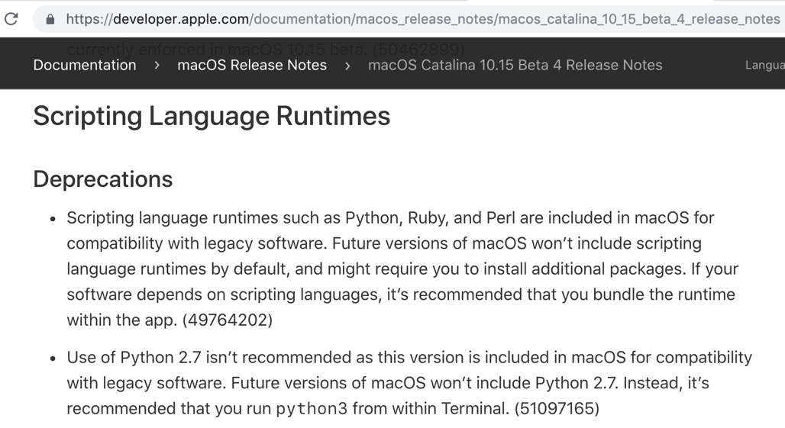
func pythonPostExSummary()

Slide 13

print(“MacOS Internals for Post-Ex?”)
Windows trend: command line → API calls
Can we follow this trend for MacOS Post-Ex?
Challenge your current detection posture

Slide 14
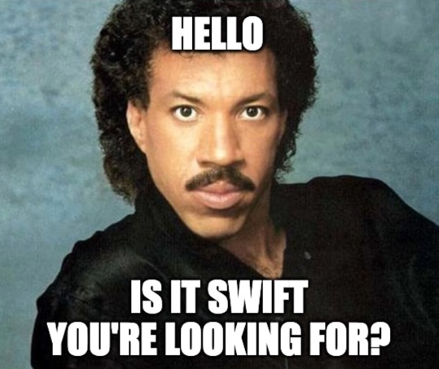
return Swift
Options for macOS Internals access
Why I chose Swift
Access same API calls (Cocoa) made from command line
Migrate away from command line

Slide 15

try overview.Swift()
Open Source (swift.org)
Alternative to Obj C
Full access to Cocoa API
“import Cocoa”
Desktop OS API
Used for development on Apple platforms
macOS apps, command line tools, kernel ext, etc.

Slide 16

let briefSetup
Download Xcode IDE
Install swift
Playgrounds – for familiarity/quick tests
Projects for larger efforts (apps, command line tools, etc.)
Compile code and run

Slide 17
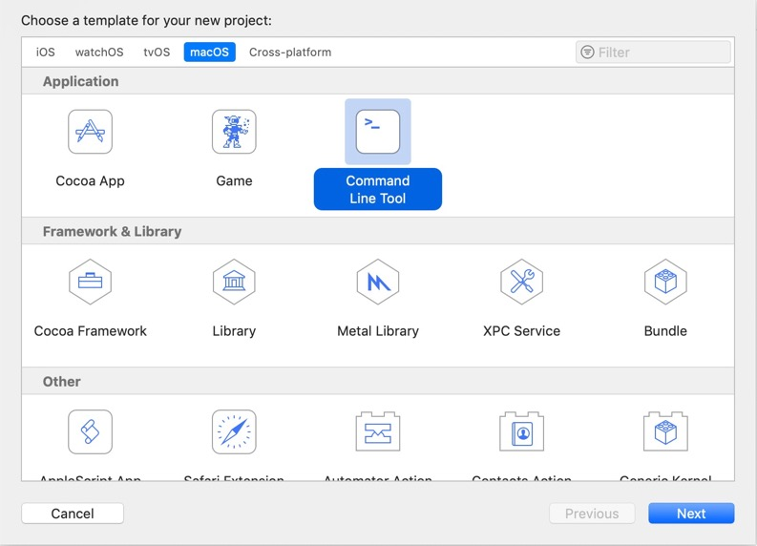
let briefSetup
File -> New
Various options
“Cmd Line Tool”
Build mach-o
Cocoa App
Build .app
Both use Cocoa API for macOS

Slide 18

var makeCmdTool
Making a New Project
mkdir
$ swift package init --type executable
$ swift package generate-xcodeproj
$ swift run
Compile code and run
$ swift run -or-
$ swift build

Slide 19
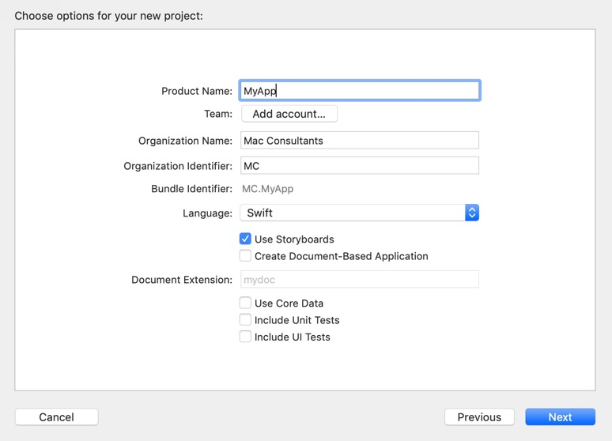
var makeApp
Making a New Project
File -> New -> Cocoa App

Slide 20
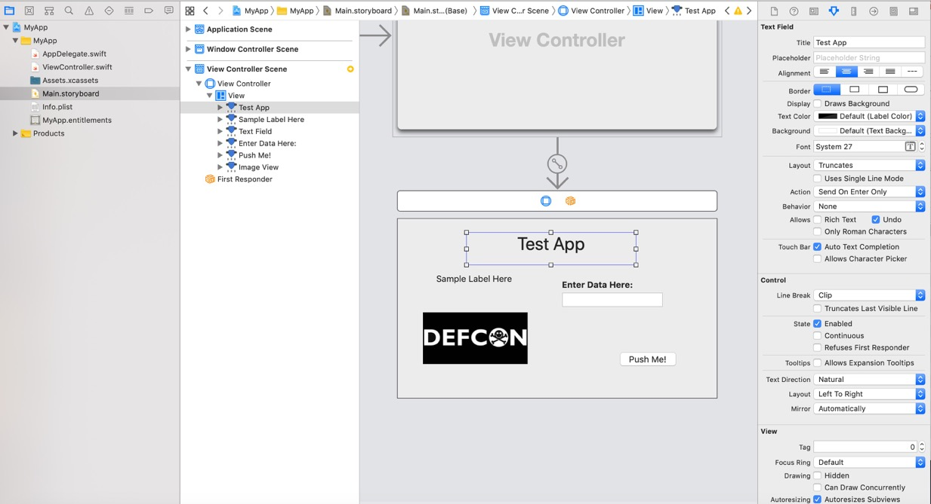

Slide 21
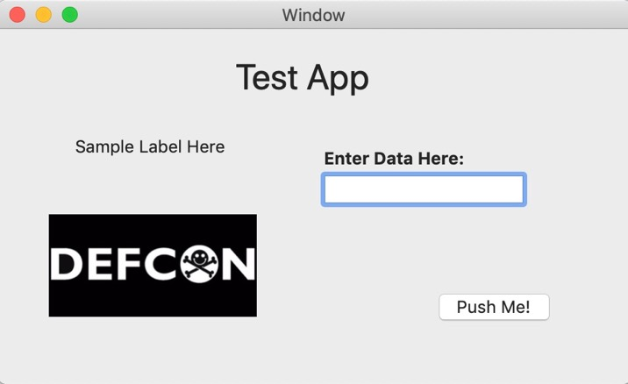
var makeApp
Run to view your App

Slide 22
func convertToSwift(cmdlinestring){}
First, a look at post exploitation in Swift for macOS “Command Line Tools” (i.e., mach-o binaries)

Slide 23
func convertToSwift(cmdlinestring){}
Taking A Screenshot
Example using command line:
“screencapture –x –t jpg out.jpg”

Slide 24
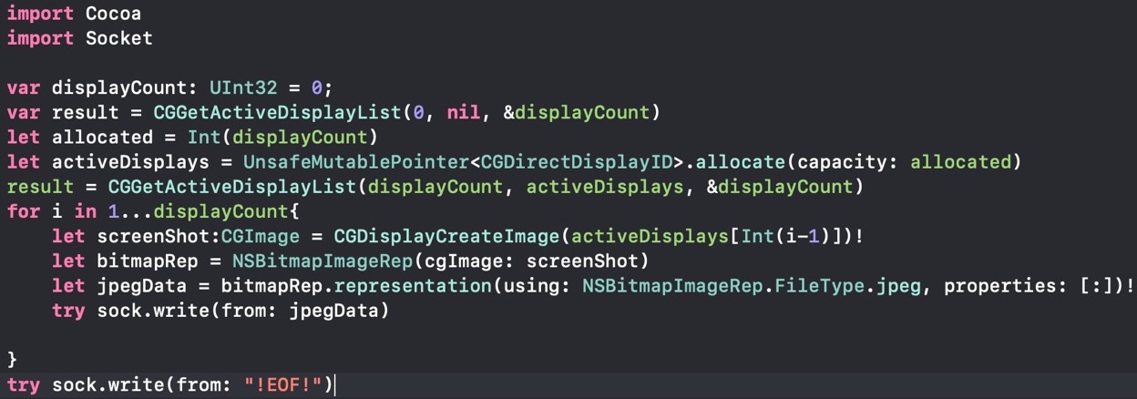
func convertToSwift(cmdlinestring){}
Example using Swift (not using command line):

Slide 25
func convertToSwift(cmdlinestring){}
Fake Authentication Prompt
Example using command line:
osascript -e ‘set popup to display dialog “Keychain Access wants to use the login keychain” & return & return & “Please enter the keychain password” & return default answer ”” with icon file “Applications:Utilities:Keychain Access.app:Contents:Resources:AppIcon.icns” with title “Authentication Needed” with hidden answer””’

Slide 26
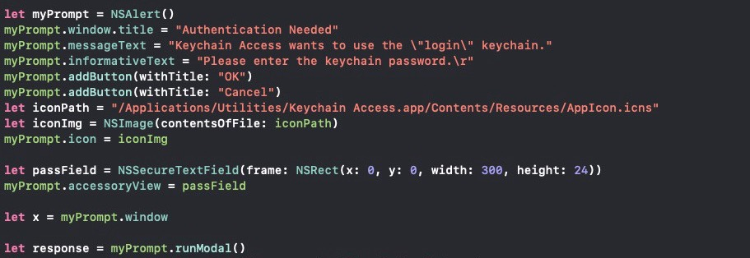
func convertToSwift(cmdlinestring){}
Example using Swift (not using command line):

Slide 27
func convertToSwift(cmdlinestring){}
Example using Swift (invokes command line…not desirable for red teaming):

Slide 28
func convertToSwift(cmdlinestring){}
Listing Internal IP Addresses
Example using command line:
ifconfig | grep -Eo 'inet (addr:)?([0-9]*\.){3}[0-9]*' | grep -Eo '([0-9]*\.){3}[0-9]*' | grep -v '127.0.0.1'

Slide 29
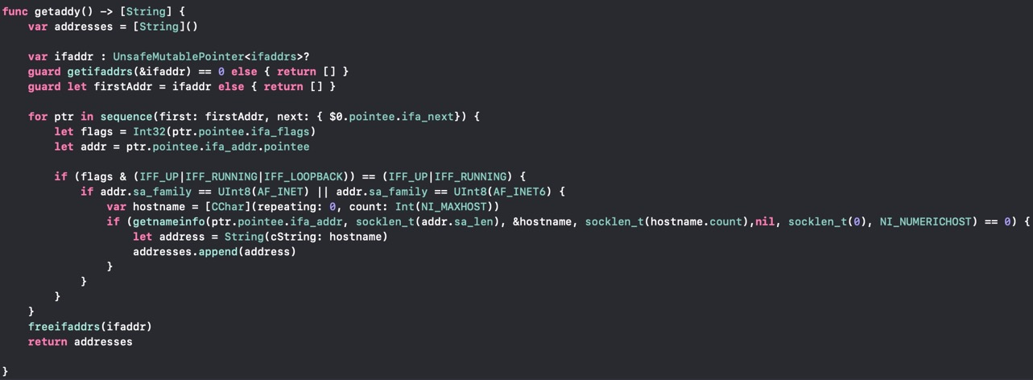
func convertToSwift(cmdlinestring){}
Example using Swift (not using command line):

Slide 30
func convertToSwift(cmdlinestring){}
Navigating The File System
Example using command line:
pwd, cd, ls

Slide 31
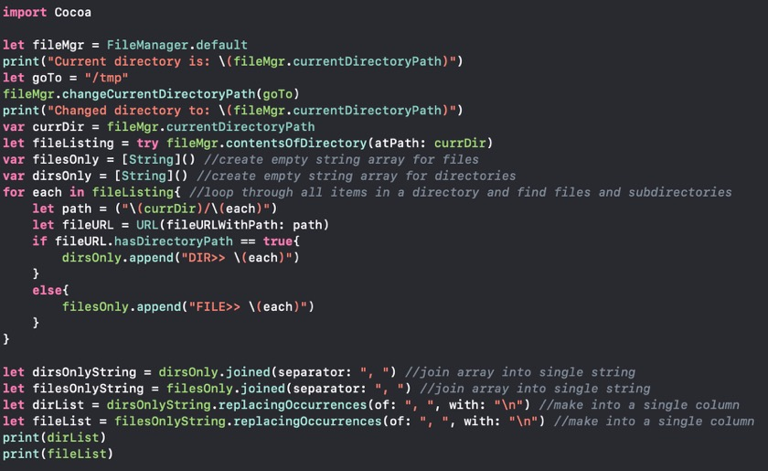
func convertToSwift(cmdlinestring){}
Example using Swift (not using command line):

Slide 32
func convertToSwift(cmdlinestring){}
Displaying file contents
Example using command line:
cat [file]

Slide 33
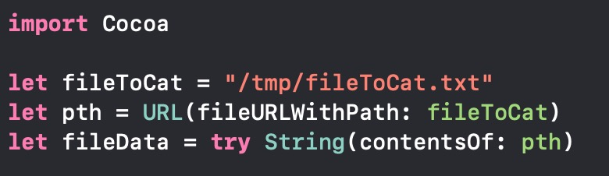
func convertToSwift(cmdlinestring){}
Example using Swift (not using command line):

Slide 34
func convertToSwift(cmdlinestring){}
Getting clipboard contents
Example using command line:
osascript -e ‘return (the clipboard)’

Slide 35
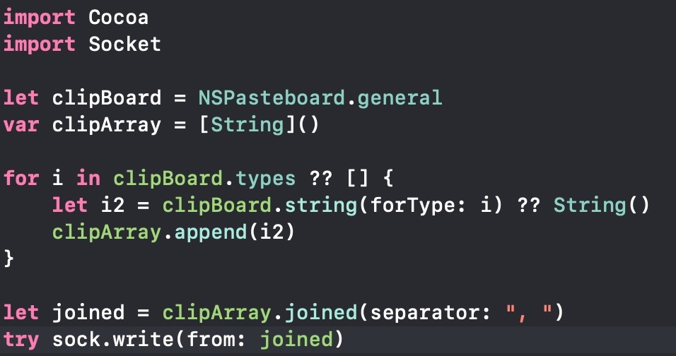
func convertToSwift(cmdlinestring){}
Example using Swift (not using command line):

Slide 36
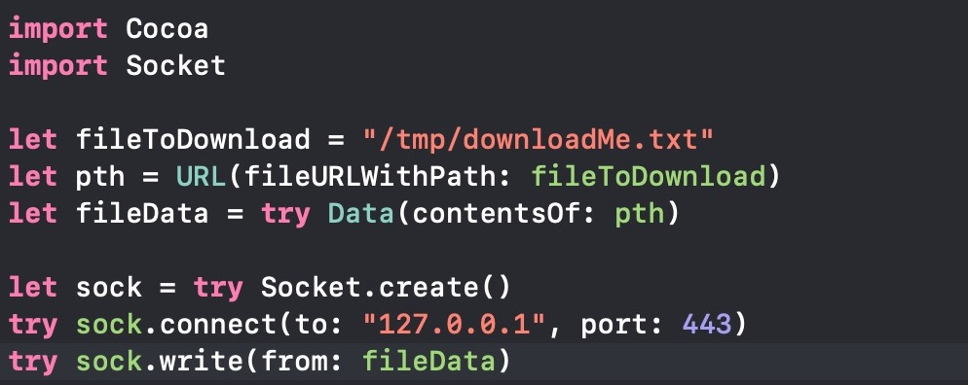
func convertToSwift(cmdlinestring){}
Example using Swift to download files:

Slide 37
func convertToSwift(cmdlinestring){}
Get info on what’s running
Example using command line:
ps aux, ps -ef

Slide 38
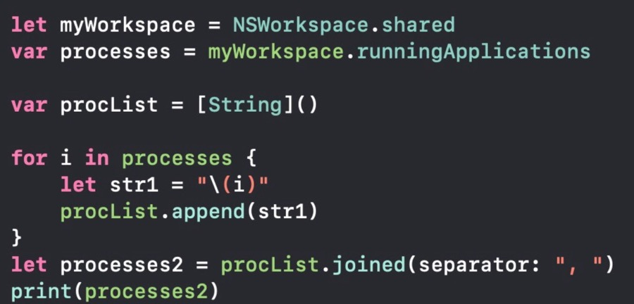
func convertToSwift(cmdlinestring){}
Example using Swift to get running apps (not the same as ps commands):

Slide 39
func convertToSwift(cmdlinestring){}
Get basic system info
Example using command line:
osascript –e ‘return (system info)’

Slide 40
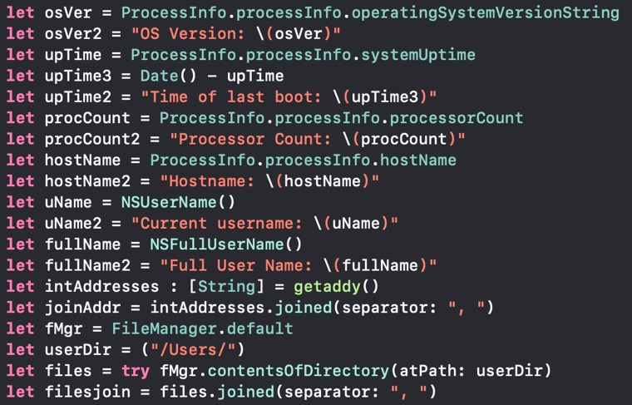
func convertToSwift(cmdlinestring){}
Example using Swift to gather basic system info:

Slide 41
//What’s Next?
A brief look at macOS Cocoa App example

Slide 43
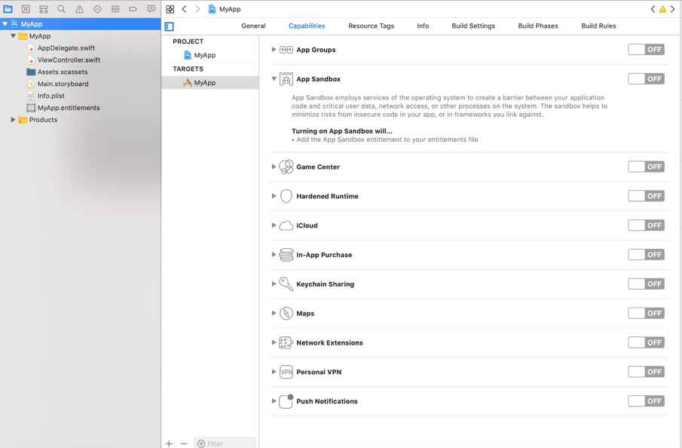
To perform “sensitive tasks”:
Specify specific access in Sandbox, or
disable sandboxing in the app
Sandboxing required for Mac App Store

Slide 44
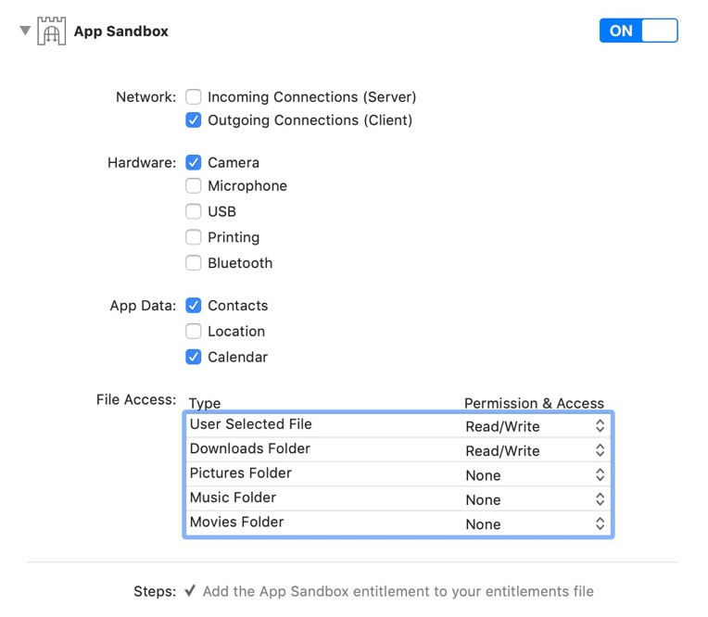
Example of Sandboxing your App

Slide 45
To Add Code Behind Window Elements

Slide 46
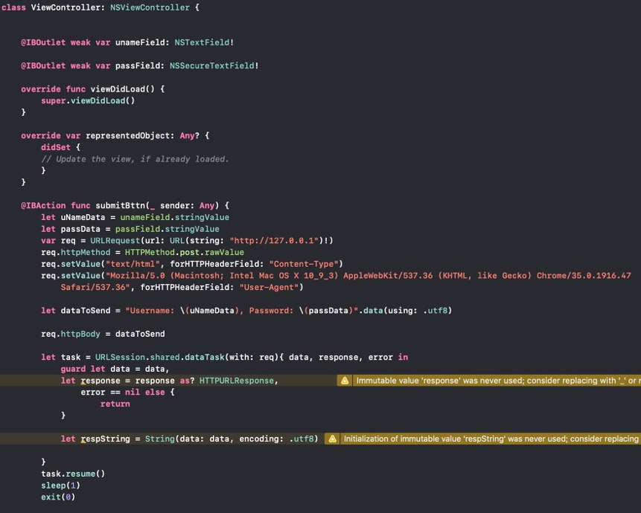
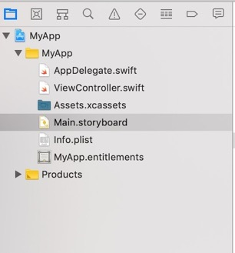
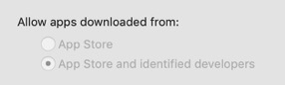
Lastly, need to sign the app using a Developer ID due to Gatekeeper or the app will not run
developer.apple.com
$99/yr

Slide 47

class Detection{}
First detect common things. Examples:
$Office_Product -> /bin/sh
$Scripting_lang -> /bin/sh
$Scripting_lang -> /usr/bin/osascript
osascript with “-e” and “popup”
osascript with “-e” and “clipboard”
Examples for malicious use of macOS internals
Network visibility
Visibility into new binaries/apps
Execution chains

Slide 48
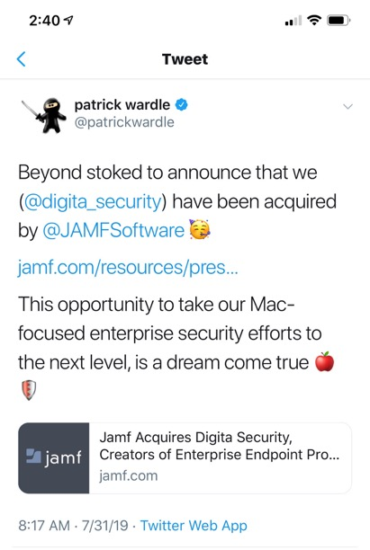
var lookInto = true
Defenders:
Keep up with Jamf and Digita Security
Execute these code samples as Xcode Playground files
Check EDR logs for gaps
Monitor network comms, execution chains

Slide 49

func Resources(){}
Link to my MacShellSwift proof of concept tool (builds macho file):
https://github.com/cedowens/MacShellSwift
Blog post:
https://medium.com/red-teaming-with-a-blue-team-mentaility/b5faaa11e121
Also check out Apfell By Cody Thomas:
https://github.com/its-a-feature/Apfell

Slide 50
